Slide 1




Week-8 (Discussion)
12th Sept, 2025
Computer Vision
Prof. Jayanta Mukhopadhyay
Professor
Computer Science and Engineering Department
IIT Kharagpur
Ayan Paul
PMRF Research Scholar
IIT Kharagpur

Slide 2
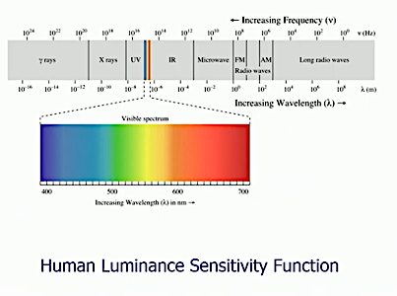
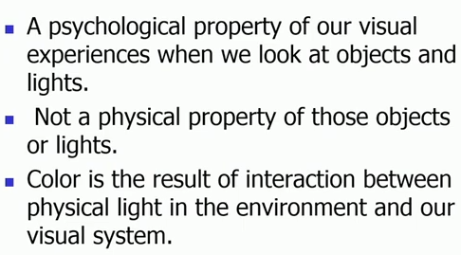
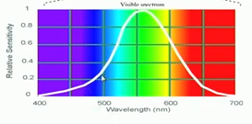
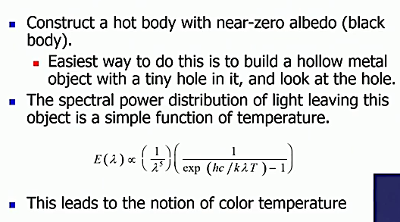
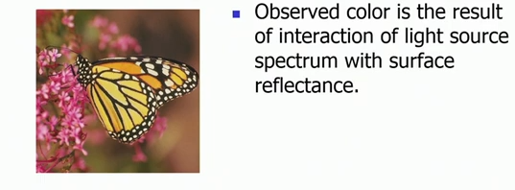
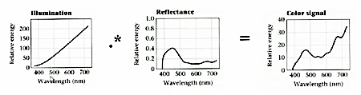
What is color?
Black body Radiators
Interaction of Light and Surfaces

Slide 3
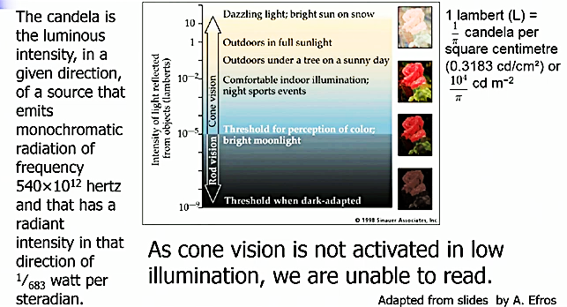
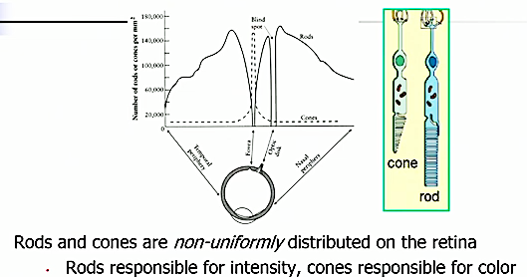
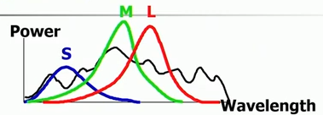
Eye cells –Rods and Cones
Rod/ Cone Sensitivity
Color Perception
Feature | Rods | Cones
Function | Night vision | Color & sharp vision
Sensitivity | High (dim light) | Low (bright light)
Color Detection | No | Yes (RGB)
Location | Peripheral retina | Central retina (fovea)
Number | ~120 million | ~6 million
Adaptation | Slow | Fast
Cone Type | Wavelength Sensitivity | Color Detected
S | ~420 nm | Blue
M | ~534 nm | Green
L | ~564 nm | Red

Slide 4
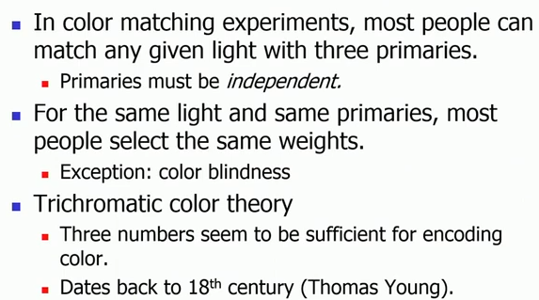
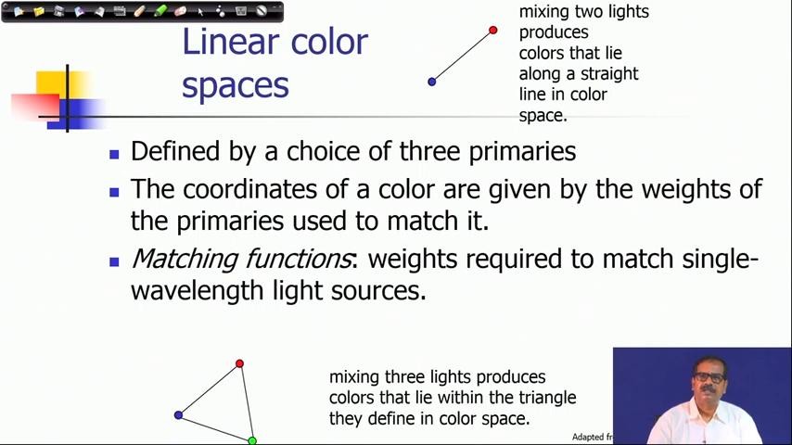
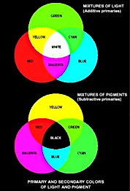
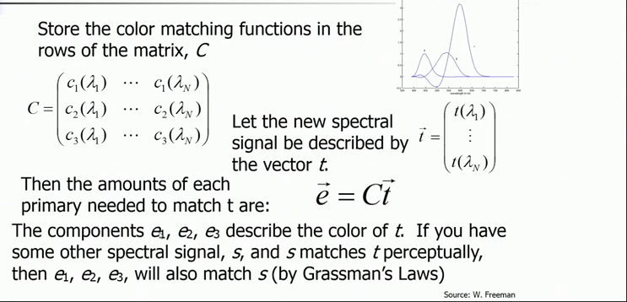
Trichromacy
Linear Color Spaces
Color Matching Functions
Addition and Subtraction of Colors

Slide 5
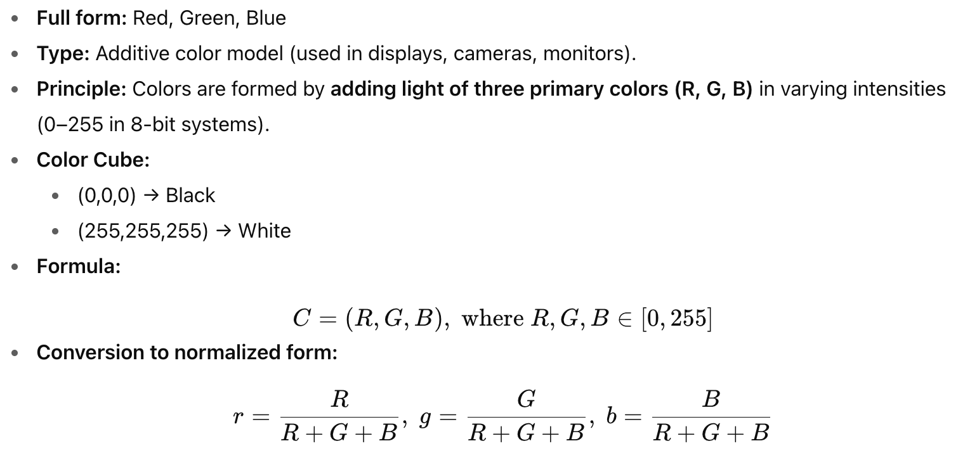
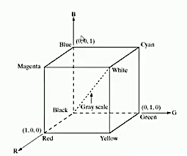
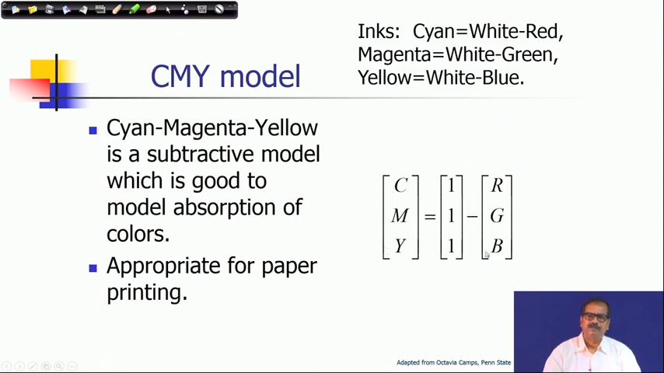
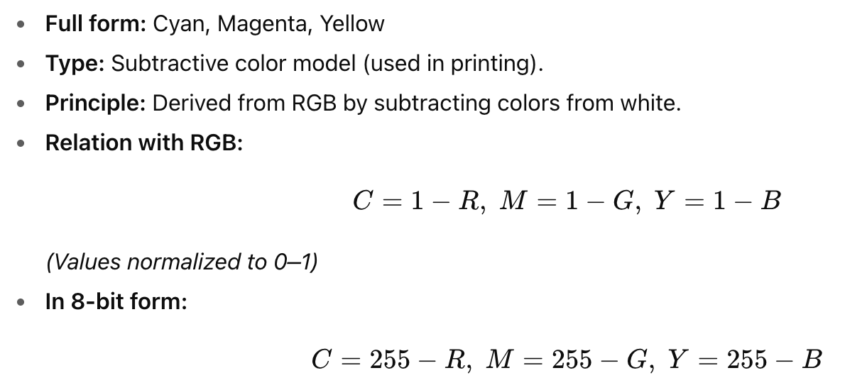
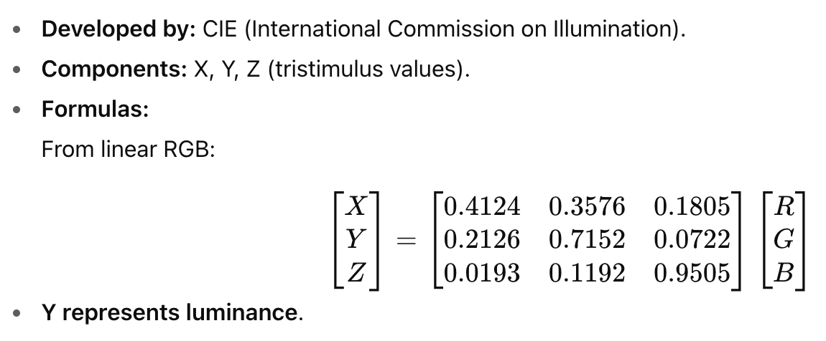
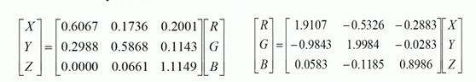
Different Color Models
RGB Model
CIE XYZ Model
CMY Model

Slide 6
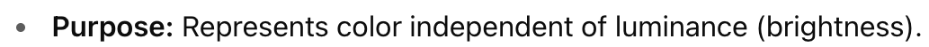
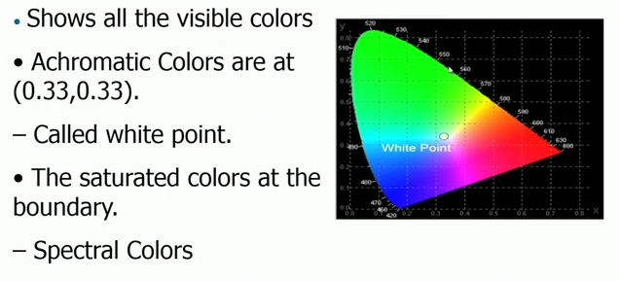
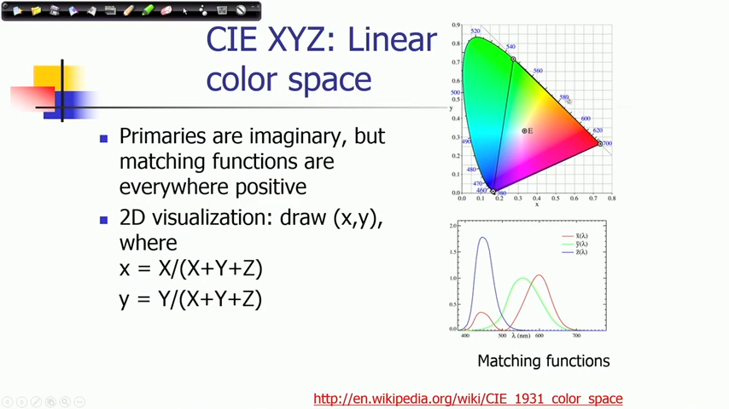
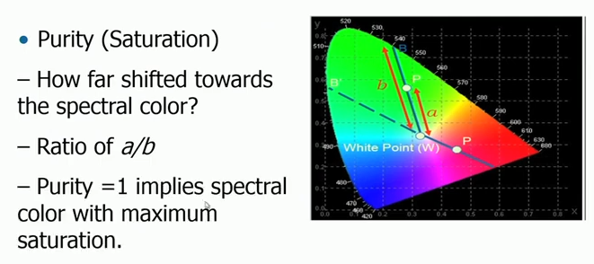
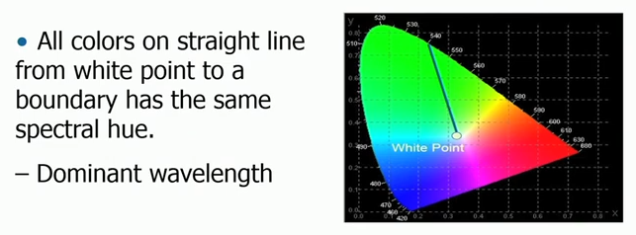
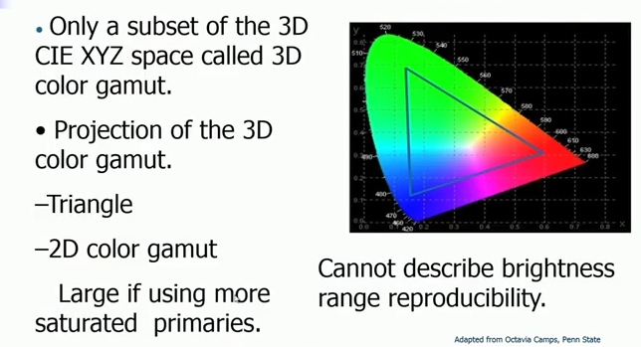
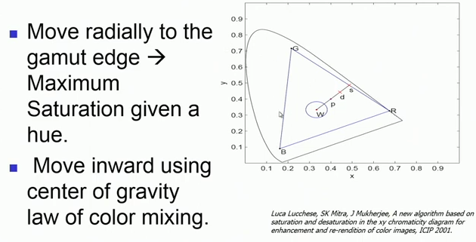
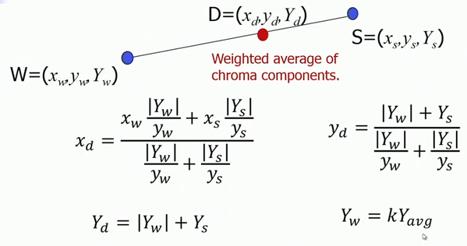
CIE Chromaticity Model
CIE Chromaticity Chart
CIE Chart Saturation
CIE Chart Hue
Color Reproducibility
Saturation Desaturation Operation
Desaturation using CG law

Slide 7
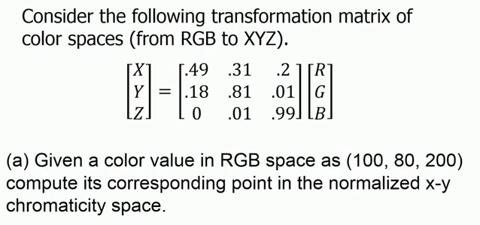
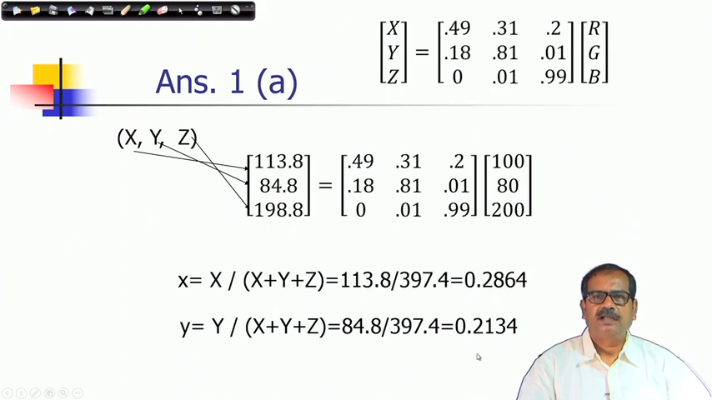
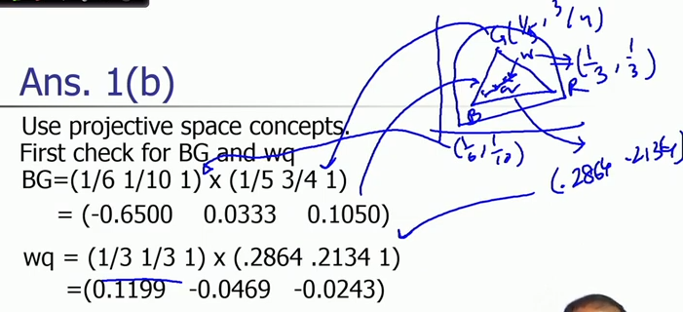
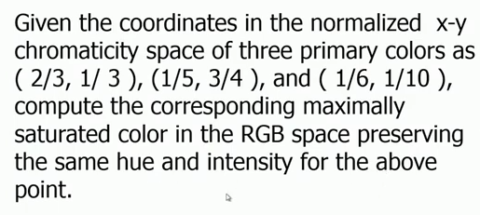
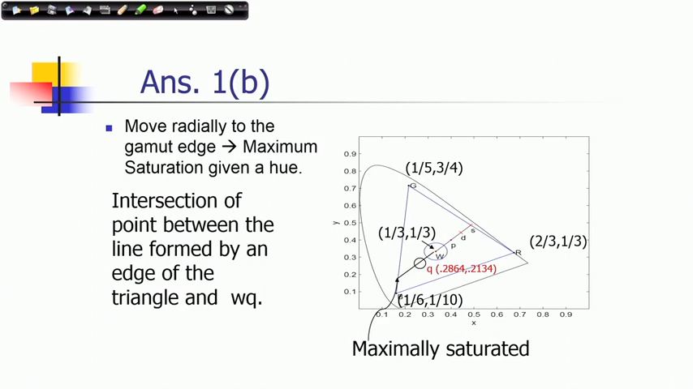
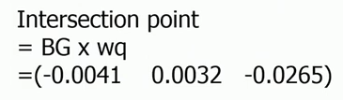
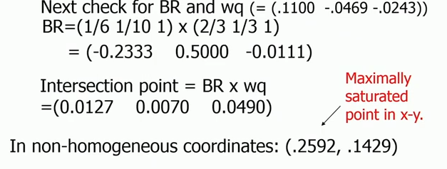
Exercise - 1
Solution
(b)

Slide 8
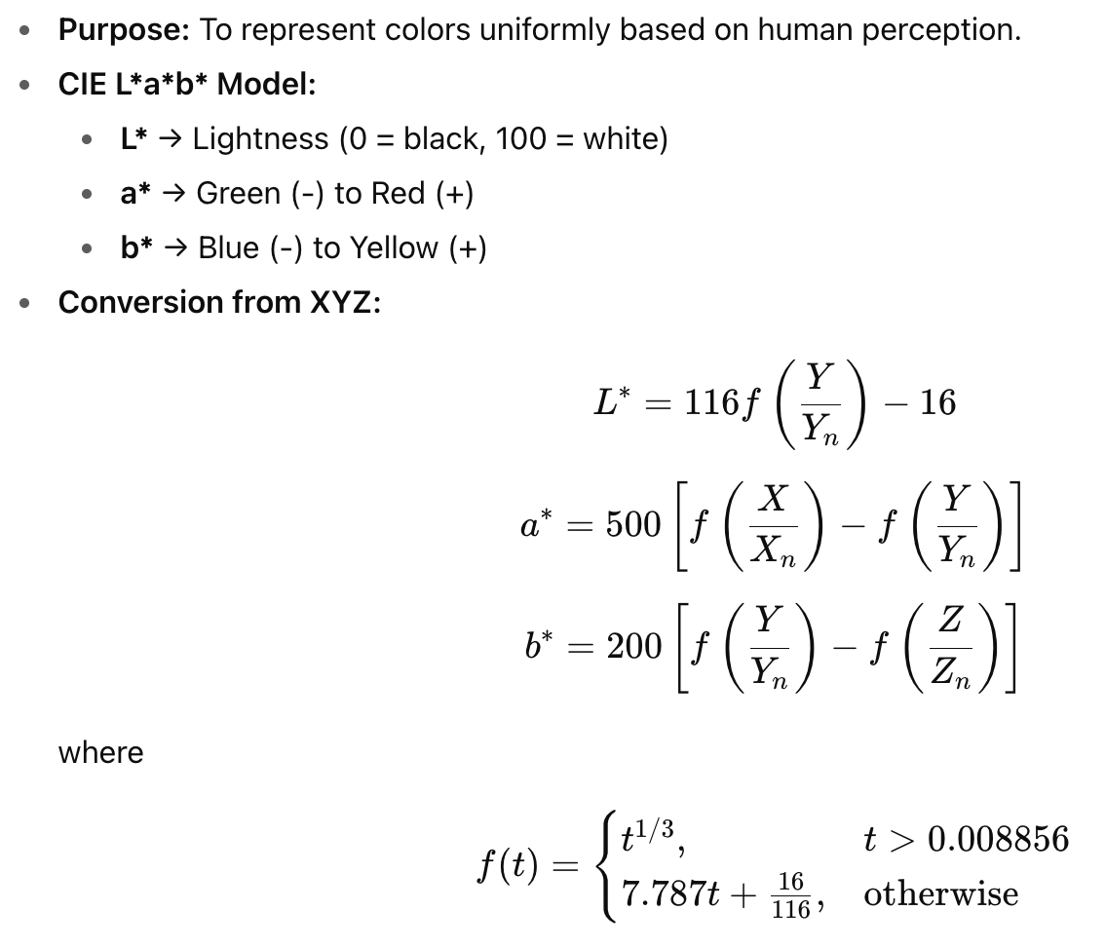
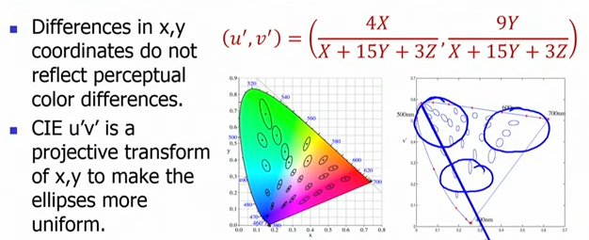
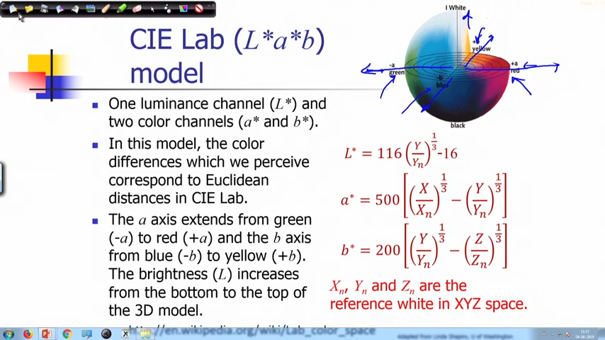
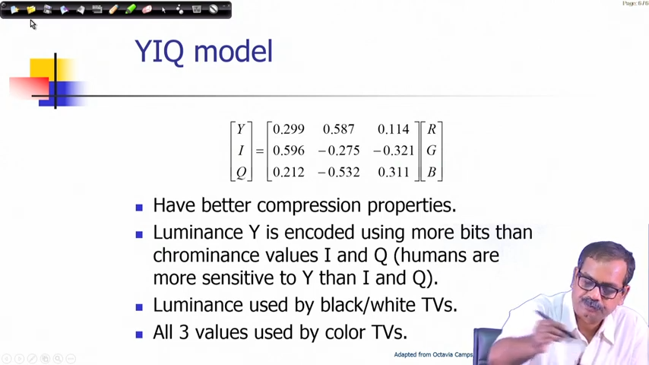
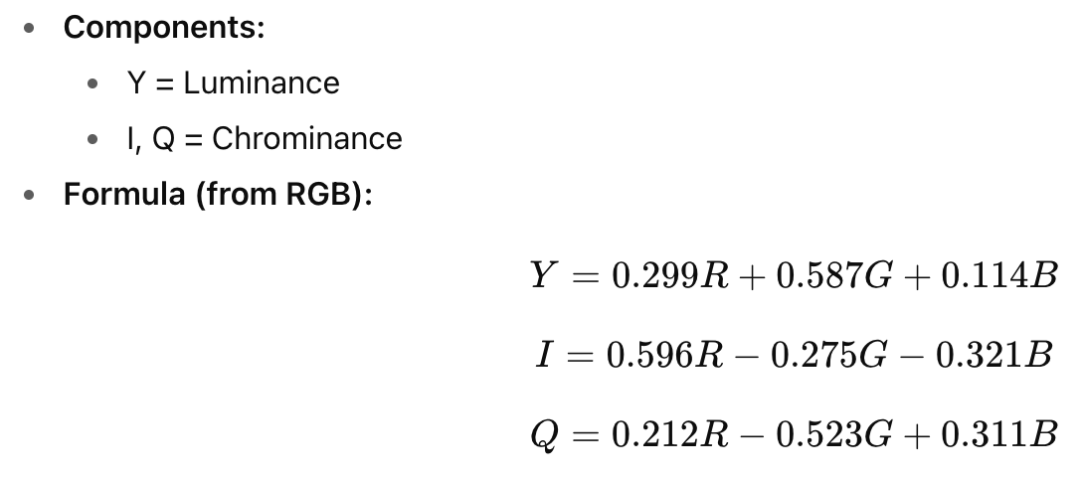
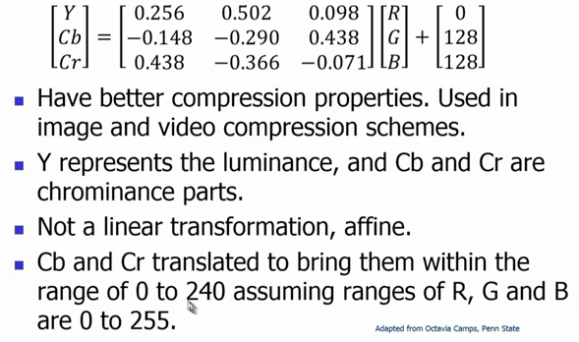
Uniform Color Spaces
CIE L*a*b* Model
Uniform Ellipses
YIQ Model
YCbCr Model

Slide 9
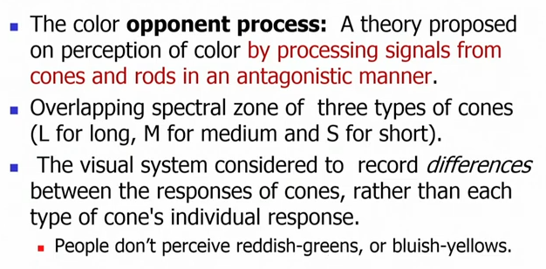
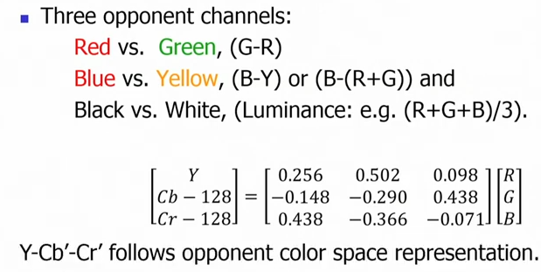
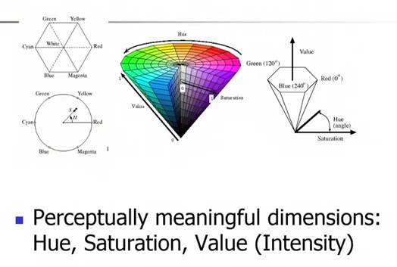
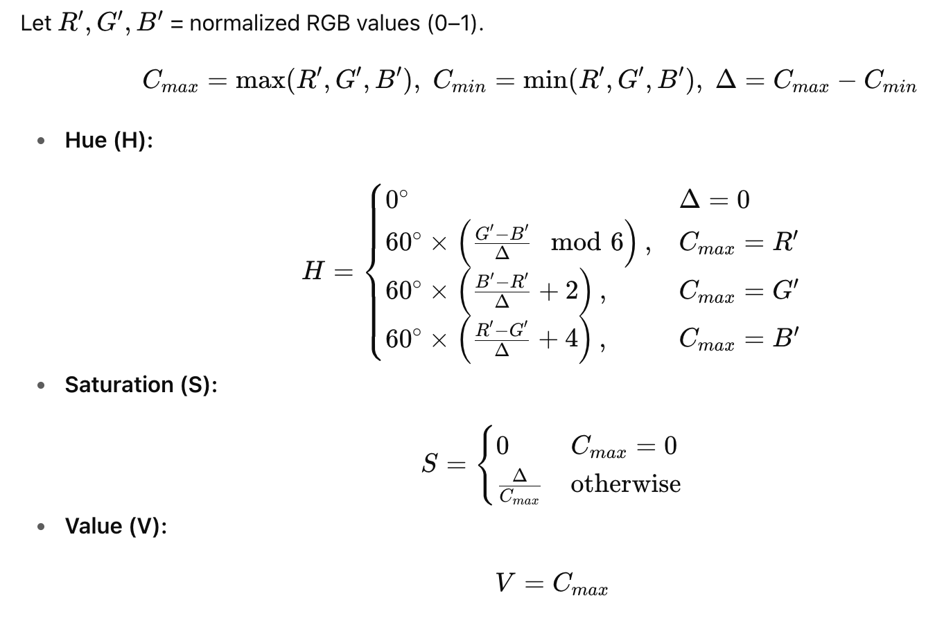
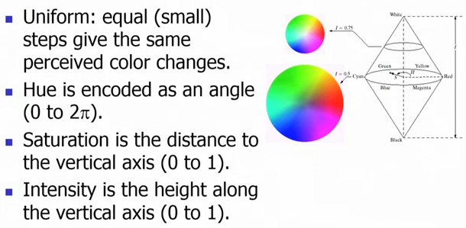
Opponent Color Processing
Non-linear Colour Spaces
HSV Model

Slide 10
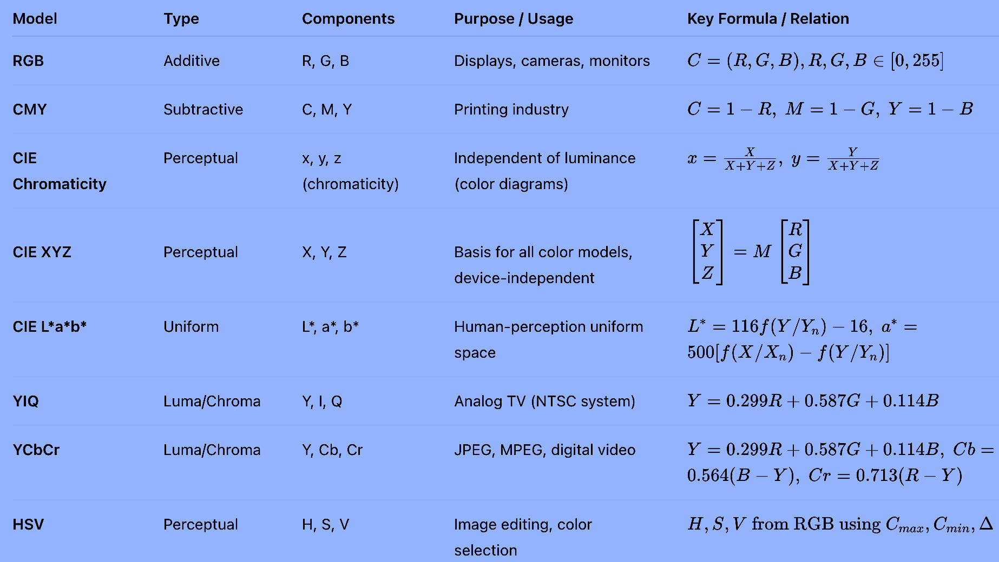
Comparison of Color Models

Slide 11
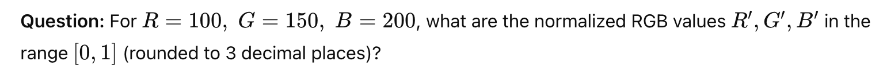
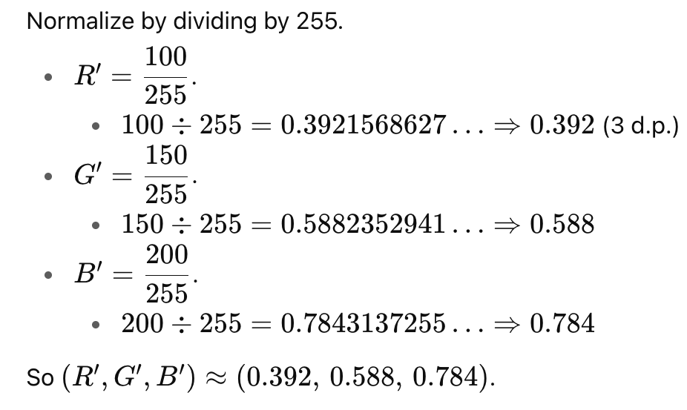
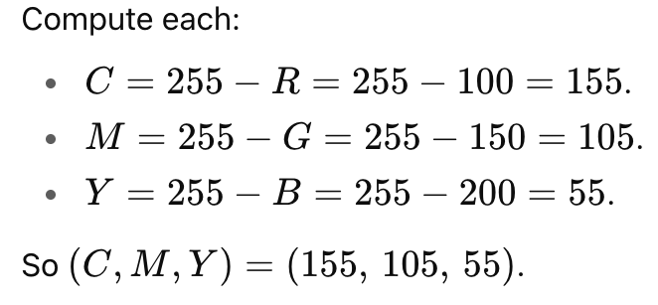
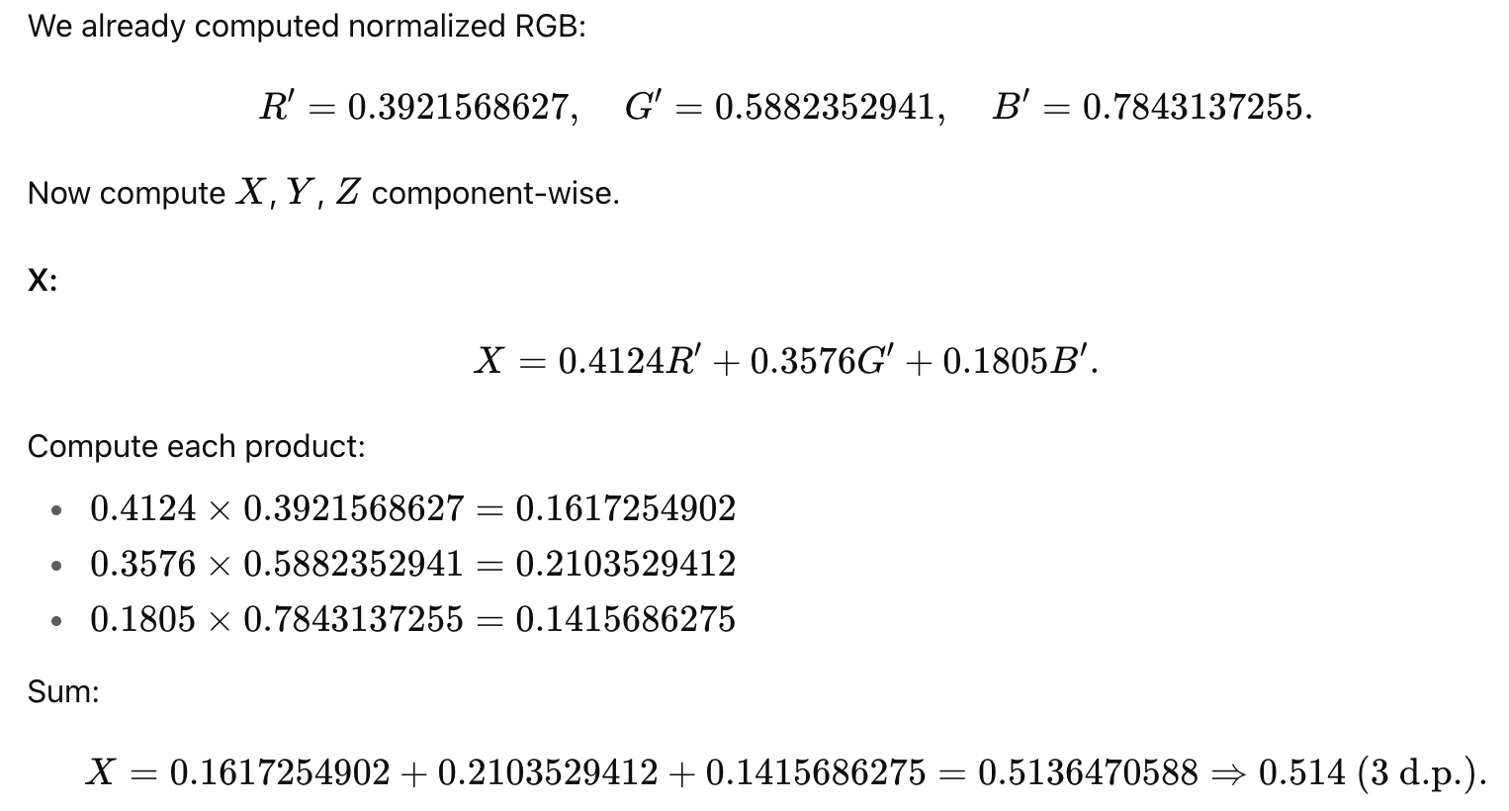




Exercise - 2
Exercise - 3
Solution
Solution
Solution
Exercise - 4

Slide 12



Exercise - 5
Exercise - 6
Solution
Solution

Slide 13






Exercise - 7
Exercise - 8
Solution
Solution
Exercise - 10
Solution

Slide 14


Exercise - 11
Exercise - 12
Solution
Solution

Slide 15






Color Constancy
White and Gray Assumption Color Constancy
Solution
Edge-based Color Constancy
Exercise - 13

Slide 16







Exercise - 14
Exercise - 15
Solution
Solution

Slide 17




Color Transfer

Slide 18




Color Demosaicing
Bilinear Interpolation
Averaging Red Blue Hues Interpolation

Slide 19





Laplacian Corrected Edge Correlated (LCEC) Interpolation
Exercise - 16
Solution
RBH
) Blue (B)

Slide 20




Slide 21
Topics on which Week 8 Assignment Questions are based
Color Definition and Color Perception
Trichromacy, Linear Color Spaces and Color Matching
Color Models – RGB, CMY, CIE XYZ, CIE Chromaticity, CIE La*b*, YIQ, YCbCr, HSV
Color Constancy
Color Transfer
Color Demosaicing and Interpolarions – Bilinear, Averaging Red Blue Hues, and Laplacian Corrected Edge Correlated (LCEC)

Slide 22


Slide 23


QUESTION 1
SOLUTION 1
CORRECT ANSWER 1
a)

Slide 24




QUESTION 2
SOLUTION 2
CORRECT ANSWER 2
b)

Slide 25


QUESTION 3
Which of the following statements are correct?
a) Color captured in the RGB color spaceis not suitable for direct interpretation of color
components.
b) CIE Chromaticity Chart represents colors in a 2-D space according to tri-stimulus model
of color representation.
c) In digital cameras color images are mostly captured using a CFA.
d) Luminance Y is encoded using less bits than chrominance values I and Q.
SOLUTION 3
CORRECT ANSWER 3
a), b), c)

Slide 26




QUESTION 4
Consider that the color of a source illuminant is represented by an RGB vector (100, 150, 200), whereas the target color is given by (50, 150, 100). Given a color vector (100, 100, 100) in the source image, compute the color corrected vector using diagonal correction rule.
a) (150, 75, 150)
b) (75, 150, 75)
c) (50, 100, 50)
d) (100, 50, 100)
SOLUTION 4
CORRECT ANSWER 4
b)

Slide 27





QUESTION 5
Interpolate G5 using laplacian corrected edge correlated interpolation using given Bayer’s pattern.
SOLUTION 5
CORRECT ANSWER 5
103

Slide 28
QUESTION 6
Given the coordinates in the normalized x-y chromaticity space of three primary colors as (2/3, 1/3), (1/5, 3/4), and (1/6, 1/10), compute the corresponding maximally saturated color in the x-y chromaticity space preserving the same hue and intensity for the given point (0.31, 0.27) in x-y chromaticity space. Evaluate all the results upto three decimal places.
a) approximately (0.489, 0.308)
b) approximately (0.708, 0.186)
c) approximately (0.189, 0.108)
d) approximately (0.208, 0.286)
SOLUTION 6
Given the three primary colors as R = (2/3, 1/3), G = (1/5, 3/4), and B = (1/6, 1/10) in x-y chromaticity space.
We have white point w = (1/3, 1/3) and a given point q = (0.31, 0.27).
If you move the point radially to the gamut edge, you will find a Maximum Saturation given a hue.
Intersection of point between the line formed by an edge of the triangle and wq, will be the required answer.
Use the projective space concept of cross product between two points will give you a line passing through the points.
BG = (1/6, 1/10, 1) × (1/5, 3/4, 1) = (−0.65, 0.033, 0.105)
BR = (−0.233, 0.5, −0.011)
GR = (0.417, 0.467, −0.433)
wq = (0.063, −0.023, −0.013)
BG × wq = (0.002, −0.002, 0.013) → Not a point within the x-y space.
GR × wq = (−0.016, −0.022, −0.039) → maximally saturated point (0.410, 0.564)
BR × wq = (−0.007, −0.004, −0.026) → maximally saturated point (0.269, 0.154)
None of the Above
CORRECT ANSWER 6

Slide 29

Based on the given information, solve questions 7 and 8.

Slide 30


QUESTION 7
SOLUTION 7
CORRECT ANSWER 7
59.5

Slide 31




QUESTION 8
SOLUTION 8
CORRECT ANSWER 8
83

Slide 32


QUESTION 9
Which of the following statements are true?
a) Image reconstruction using color demosaicing lead to sharp edges in an image.
b) Green channel is less likely to be aliased.
c) In CFA, green channels are sampled at a higher rate than red and blue.
d) High correlation between red, green and blue channels are very likely to have similar
texture and edge locations.
SOLUTION 9
CORRECT ANSWER 9
b), c), d)

Slide 33


QUESTION 10
Given Bayer’s pattern.
SOLUTION 10
CORRECT ANSWER 10
135

